Slide 1


Slide 2
Spring Framework
Spring is a lightweight framework. It can be thought of as a framework of frameworks because it provides support to various frameworks such as Struts, Hibernate, Tapestry, EJB, JSF etc. The framework, in broader sense, can be defined as a structure where we find solution of the various technical problems.
The Spring framework comprises several modules such as IOC, AOP, DAO, Context, ORM, WEB MVC etc. We will learn these modules in next page. Let's understand the IOC and Dependency Injection first.

Slide 3
Inversion Of Control (IOC) and Dependency Injection
These are the design patterns that are used to remove dependency from the programming code. They make the code easier to test and maintain. Let's understand this with the following code:
class Employee{
Address address;
Employee(){
address=new Address();
}
}
In such case, there is dependency between the Employee and Address (tight coupling).

Slide 4
In the Inversion of Control scenario, we do this something like this:
class Employee{
Address address;
Employee(Address address){
this.address=address;
}
}
Thus, IOC makes the code loosely coupled. In such case, there is no need to modify the code if our logic is moved to new environment.
In Spring framework, IOC container is responsible to inject the dependency. We provide metadata to the IOC container either by XML file or annotation.
Advantage of Dependency Injection
makes the code loosely coupled so easy to maintain
makes the code easy to test

Slide 5
Advantages of Spring Framework
1) Predefined Templates
Spring framework provides templates for JDBC, Hibernate, JPA etc. technologies. So there is no need to write too much code. It hides the basic steps of these technologies.
Let's take the example of JdbcTemplate, you don't need to write the code for exception handling, creating connection, creating statement, committing transaction, closing connection etc. You need to write the code of executing query only. Thus, it save a lot of JDBC code.
2) Loose Coupling
The Spring applications are loosely coupled because of dependency injection.
3) Easy to test
The Dependency Injection makes easier to test the application. The EJB or Struts application require server to run the application but Spring framework doesn't require server.

Slide 6
4) Lightweight
Spring framework is lightweight because of its POJO implementation. The Spring Framework doesn't force the programmer to inherit any class or implement any interface. That is why it is said non-invasive.
5) Fast Development
The Dependency Injection feature of Spring Framework and it support to various frameworks makes the easy development of JavaEE application.
6) Powerful abstraction
It provides powerful abstraction to JavaEE specifications such as JMS, JDBC, JPA and JTA.
7) Declarative support
It provides declarative support for caching, validation, transactions and formatting.

Slide 7
Spring Modules
The Spring Framework consists of features organized into about 20 modules. These modules are grouped into Core Container, Data Access/Integration, Web, AOP (Aspect Oriented Programming), Instrumentation, and Test, as shown in the following diagram.

Slide 8
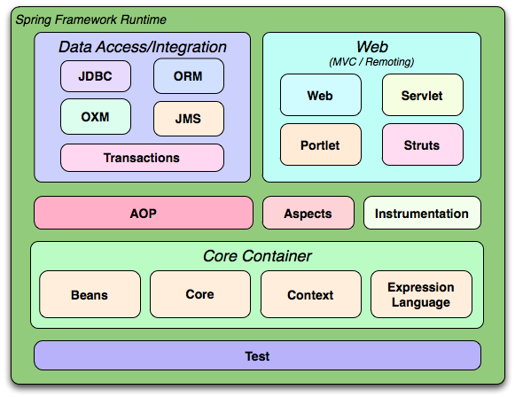

Slide 9
Test
This layer provides support of testing with JUnit and TestNG.
Spring Core Container
The Spring Core container contains core, beans, context and expression language (EL) modules.
Core and Beans
These modules provide IOC and Dependency Injection features.
Context
This module supports internationalization (I18N), EJB, JMS, Basic Remoting.
Expression Language
It is an extension to the EL defined in JSP. It provides support to setting and getting property values, method invocation, accessing collections and indexers, named variables, logical and arithmetic operators, retrieval of objects by name etc.

Slide 10
AOP, Aspects and Instrumentation
These modules support aspect oriented programming implementation where you can use Advices, Pointcuts etc. to decouple the code.
The aspects module provides support to integration with AspectJ.
The instrumentation module provides support to class instrumentation and classloader implementations.
Data Access / Integration
This group comprises of JDBC, ORM, OXM, JMS and Transaction modules. These modules basically provide support to interact with the database.
Web
This group comprises of Web, Web-Servlet, Web-Struts and Web-Portlet. These modules provide support to create web application.

Slide 11
IoC Container
The IoC container is responsible to instantiate, configure and assemble the objects. The IoC container gets informations from the XML file and works accordingly. The main tasks performed by IoC container are:
to instantiate the application class
to configure the object
to assemble the dependencies between the objects
There are two types of IoC containers. They are:
BeanFactory
ApplicationContext

Slide 12
Difference between BeanFactory and the ApplicationContext
The org.springframework.beans.factory. BeanFactory and the org.springframework.context. ApplicationContext interfaces acts as the IoC container. The ApplicationContext interface is built on top of the BeanFactory interface. It adds some extra functionality than BeanFactory such as simple integration with Spring's AOP, message resource handling (for I18N), event propagation, application layer specific context (e.g. WebApplicationContext) for web application. So it is better to use ApplicationContext than BeanFactory.

